Slide 1

Workflow Guide For Health Facility Assessment Analysis
BY
Oluwasola Aduewa
6/09/2025

Slide 2
Workflow Overview
SQLite DB
Unprocessed data
ETL
Load
Data modeling
Schema setup
Define constraints
Load/save data
Check list
Download Zip file
Unpack zip file
Extract facility locations & senatorial district
Prepare/clean data set for joins

Slide 3
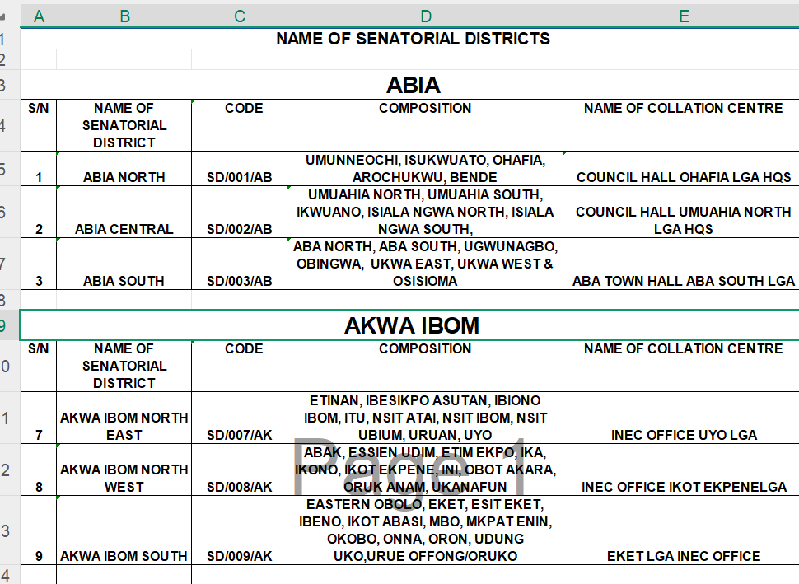

Addressing Data Quality Problems
Fix senatorial district data problem
Get the state on a single column
Align state, code, composition and collation Centre in a table
Explode senatorial compositions
Each senatorial composition must be on a row
Watch out for Unicode characters
Strip of empty spaces around texts

Slide 4
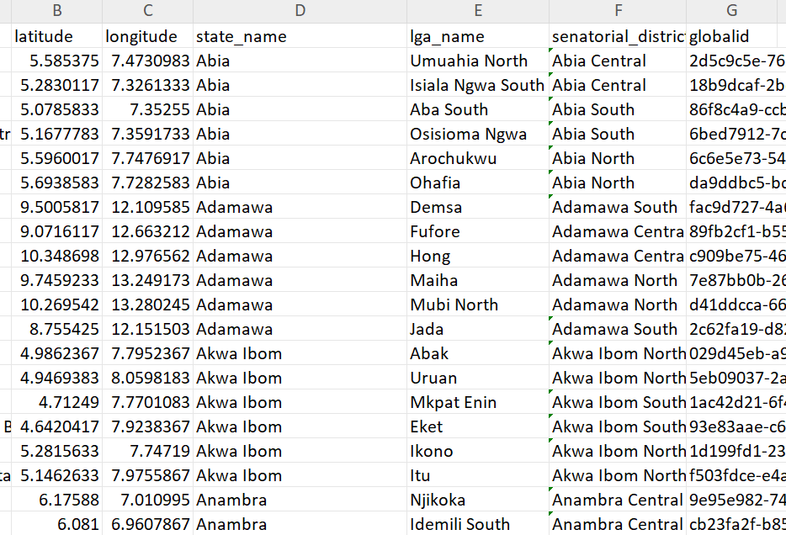
Mechanics
state name on the left match state name on the right
&
Senatorial district on left must match composition on the right

Slide 5

HF data
HF Score
Senatorial district
Global id =uuid
More Joins
A 100% join indicates a neatly done cleaning operation

Slide 6
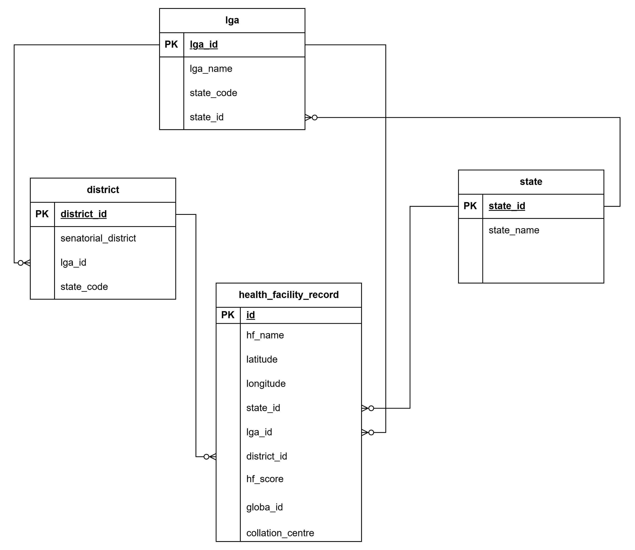

Data modelling: ERD
Create schema according to this ERD
Set constraints in case of future data
Load to database: SQLite3

Slide 7

Map production
Create map with Geopandas.
Find Maximum per senatorial score per senatorial district
Layer max score & facility name on the map

